Slide 1

Capstone Project - 1
Play Store App Review Analysis Team Member Ganesh Kumar Akanksha Agarwal Rahul Mishra Shivam Singh Dashrath Singh

Slide 2
INDEX
TOPIC
Introduction ----------------------------
Problem Comprehension -----------------
Dataset Description -------------------------
Data Exploration ------------------------------
Extracting Statistics -------------------------
Data Cleaning ---------------------------------
Exploratory&Visualization Analysis----
EDA on Review Dataset --------------------
Data Cleaning on review Dataset -------
Visualization Analysis ----------------------
Conclusion -------------------------------------
PAGE No.
0-1
2-3
4-5
6-9
10
11-16
17-32
33
34
35-38
39

Slide 3

Introduction
Mobile applications have enormous potential to drive one's business to reach great heights, as they are lucrative and easy to create. For these reasons, it becomes essential to do comprehensive analysis of play store app data and understand the demand of users.
Thus, in this project we have tried our level best to do all possible analysis and bring out some insights from the data to devise strategies for growth and retention.

Slide 4
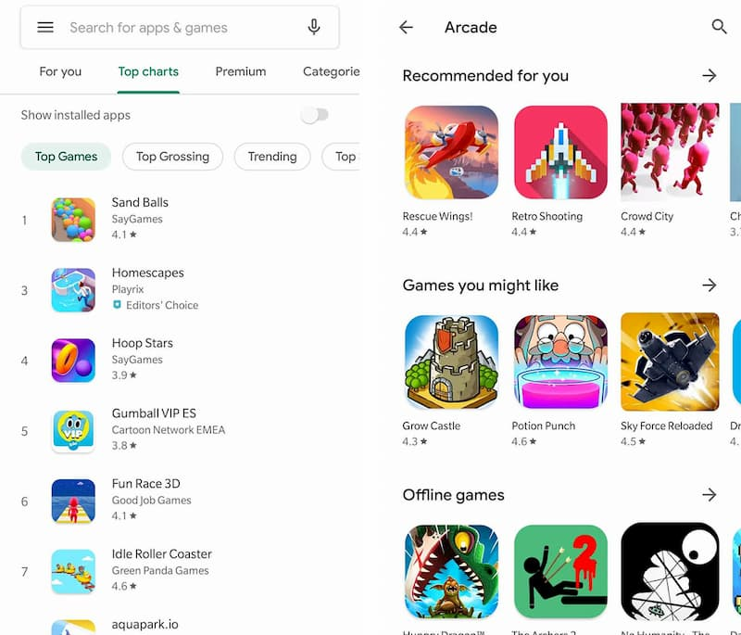
Problem Comprehension
Discussion of Google play store dataset will involve various steps such as:
Loading the data into data frame.
Cleaning the data.
extracting statistics from the dataset.
exploratory analysis and visualizations.
questions that can be asked from the dataset.
Conclusion.

Slide 5

We have used below libraries to load the data from csv file and perform some relevant analysis.
Numpy
Pandas
Matplotlib
Seaborn
Dataset reference - AlmaBetter site
https://drive.google.com/drive/folders/1j6esDUtS0hmPddXMEerNjT4X2ol3XbX3?usp=sharing

Slide 6
Dataset Description
A. Play store Dataset - This file contains data of the Play store applications. It contains 10,841 rows of data with different application names and following columns:
App: It defines names of different applications to be reviewed.
Category: Category of the application it belongs to such as family, game, beauty, business, entertainment, education...etc.
Rating: Overall user rating of the application. The users have rated the app out of 5, with 1 being the lowest rating and 5 being the highest.
Reviews: The number of user reviews each app has received.
Size: The memory size needed to install the application.
Installs: The number of times each application has been installed by users.
Type: Tells about the Free or paid version of the app.
Price: Notifies the price of the app.
Content Rating: This column specifies the intended audience of the app such as teens, mature 21+, or everyone.
Genres: The sub-category for each app. Example: for the Education category, this could be Education: Pretend Play, for example.
Last Updated: Release date of the most recent update for the app.
Current Ver: The app's current version.
Android Ver: The oldest version of Android OS supported by the app.

Slide 7
B. Review Dataset - This dataset contains the result of the sentiment analysis. It has 64,295 rows of data with the following additional attributes:
App: Name of the applications.
Translated Review: Either the original review in English, or a translated version if the orignal review is in another language.
Moreover, the text in each review was pre-processed and attributed with three new features:
Sentiment: The result of the sentiment analysis conducted on a review dataset. The value is either Positive, Neutral, or Negative. In this, the text in each review has been pre-processed and attributed with three new features.
Sentiment Polarity: Sentiment polarity is a value indicating the positivity or negativity of the sentiment. It ranges from -1 (most negative) to 1 (most positive).
Sentiment Subjectivity: Sentiment Subjectivity is a value ranging from 0 to 1, which indicates the subjectivity of the review. Here, lower values indicate the review which is based on factual information, and higher values indicate the review that is based on personal opinions, public opinions or judgements.

Slide 8
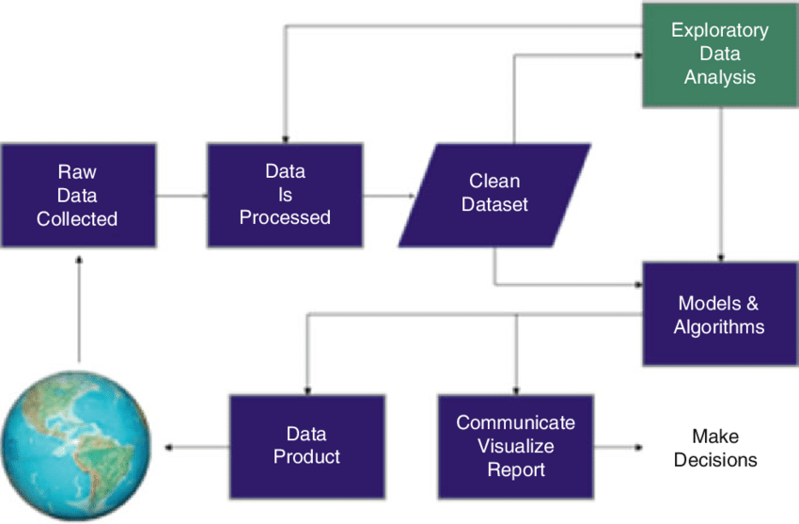
Data Exploration
Data Preparation :Data preparation is the process of cleaning and transforming raw data prior to processing and analysis. It is an important step prior to processing and often involves reformatting data, making corrections to data and the combining of data sets to enrich data.
Gathering data : This step is about getting to know the data and understanding what has to be done before the data becomes useful in a particular context. This can be done by reading the CSV file and doing initial statistical analysis.

Slide 9
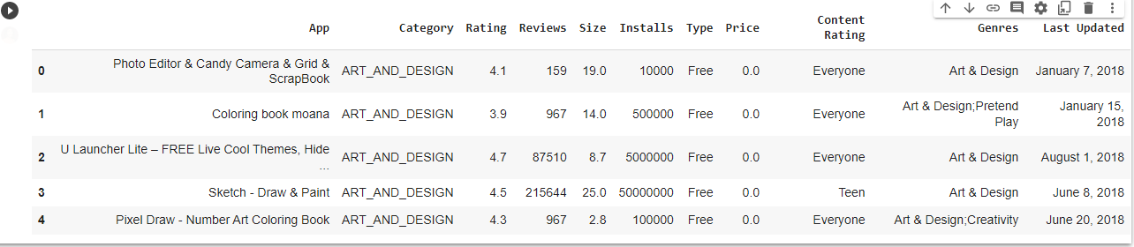
Dataset Exploration: We have exploring the Data Frame by using Head and Tail method.
Using Head we have taken out top 5 Rows from data Frame(df1).

Slide 10
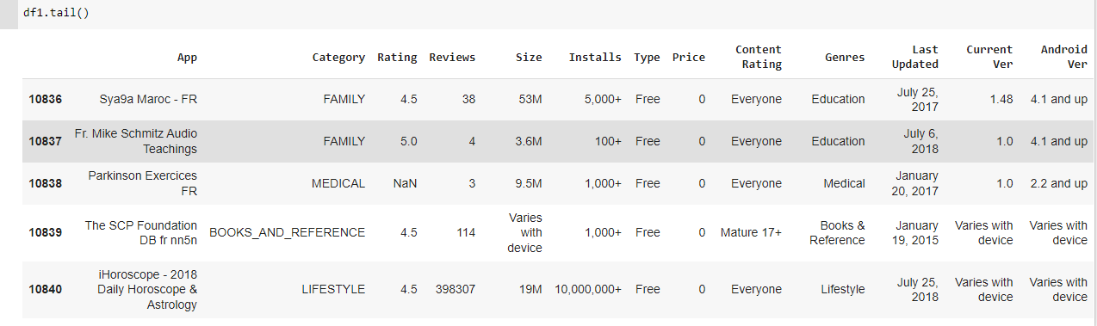
Using Tail we have taken out last 5 Rows from data Frame(df1).

Slide 11
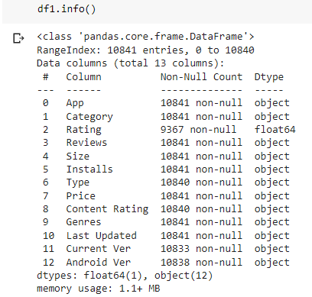
We can see from the information, that only one column i.e 'rating', belongs to numerical data type while others are categorical or object data type. Thus, one of our task will be to convert few more columns such as 'reviews', 'size', 'installs' and 'price' to numerical type so that we can perform statistical analysis on them to get some insights.
Data Frame Information -

Slide 12
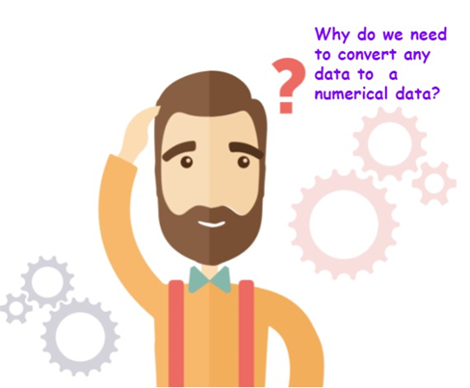
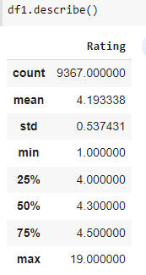
Extracting Statistics: Finding the key statistical values to fill up the missing values. Describing the numerical data of our first dataset.
We can see here, that we have only one numerical type column with its statistical values.

Slide 13

Data Cleaning :
It is a crucial step which includes:
Dropping Duplicates
Finding NaN, Nulls and missing values
Validating data to a standard pattern.
The three features that we will be working with most frequently henceforth are Installs, Size, and Price. A careful glance of the dataset reveals that some of these columns mandate data cleaning. Specifically, the presence of special characters (, $ +) and letters (M k) in the Installs, Size, and Price columns are making their conversion to a numerical data type difficult. Let's clean by removing these and converting each column to a numeric type

Slide 14
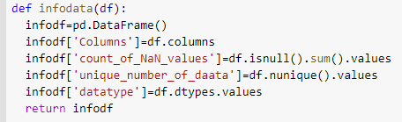

Steps which we have followed to make data Clean :
Dropping duplicate values.
Define a function to get more info from any dataset at once.
CC

Slide 15
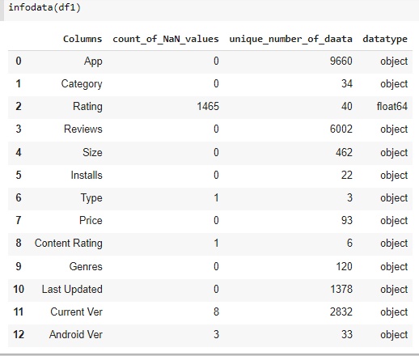
Checking more information using defined function
From this it is clear that in our dataset 'Rating' column contains 1465 null values and 'Content Rating', 'Current Ver', 'Android Ver' columns contains comparatively small amount of nulls.
Thus, now we will try to remove or replace those values in best possible way.

Slide 16
Finding nulls in 'content rating' column -
Dropping row of NaN in 'Content Rating'.
Filling na values using fillna method.
Converting KB to MB.
Replacing '+',',' with '' in 'Installs' to convert its data type
Replacing '$' with '' in 'Price' to convert its data type.
Converting 'Reviews', 'Installs', 'Size', 'Price' to numerical data type.

Slide 17
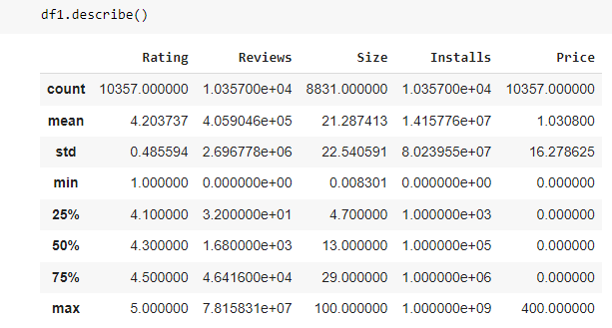
Getting statistical values of numerical columns
Now, we can see we have all five columns with numerical datatype.

Slide 18
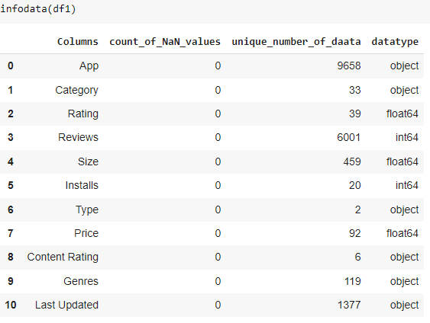

As we already know that users mostly prefer current version to take max. advantage, therefore we are dropping the 'Current Ver','Android Ver' columns.
Calling the function info data which is already defined.
Data Cleaning Completed .

Slide 19
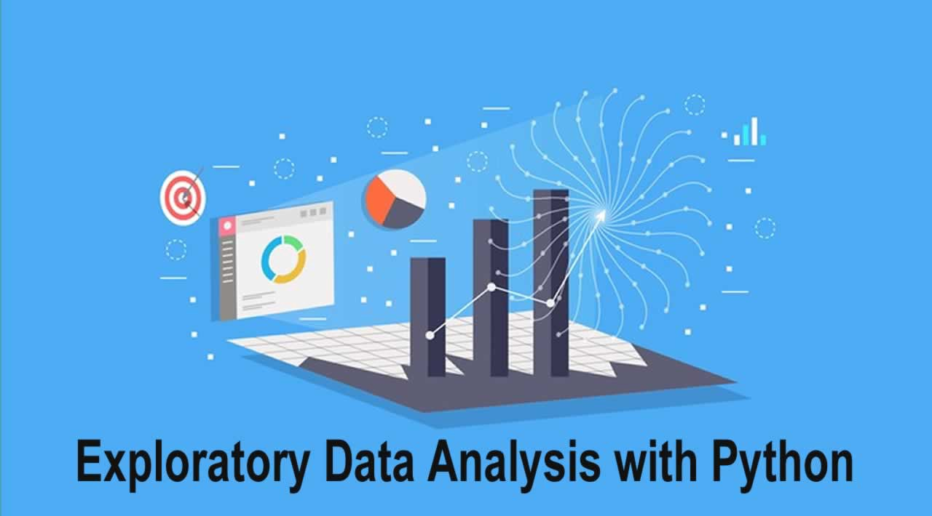

Exploratory And Visualization Analysis
We will perform analysis through our five KPIs (Key Performance Indicators) i.e 'Rating', 'Reviews', 'Size', 'Installs' and 'Price'. The analysis will be based on below method .
Univariate study- Study of dependent variables such as 'Rating', 'Reviews', 'Size', 'Installs' and 'Price'
Multivariate study- Study of multivariable and correlation between them.

Slide 20

Exploring 'Categories' of Apps:
With more than 1 billion active users in 190 countries around the world, Google Play continues to be an important distribution platform to build a global audience. For businesses to get their apps in front of users, it's important to make them more quickly and easily discoverable on Google Play. To improve the overall search experience, Google has introduced the concept of grouping apps into categories.
This brings us to the following questions:
Which top 3 category shares more number of apps?
Which are the top 25 categories comprising maximum paid and free apps?
Which categories of apps are less popular?

Slide 21
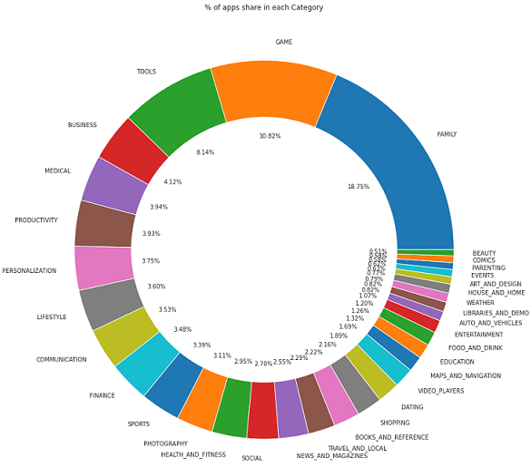
Which top 3 category shares more number of apps?
From the doughnut chart we can conclude that there are greater number of apps related to below categories:
Family- 18.75%
Game- 10.82%
Tools-8.14%

Slide 22
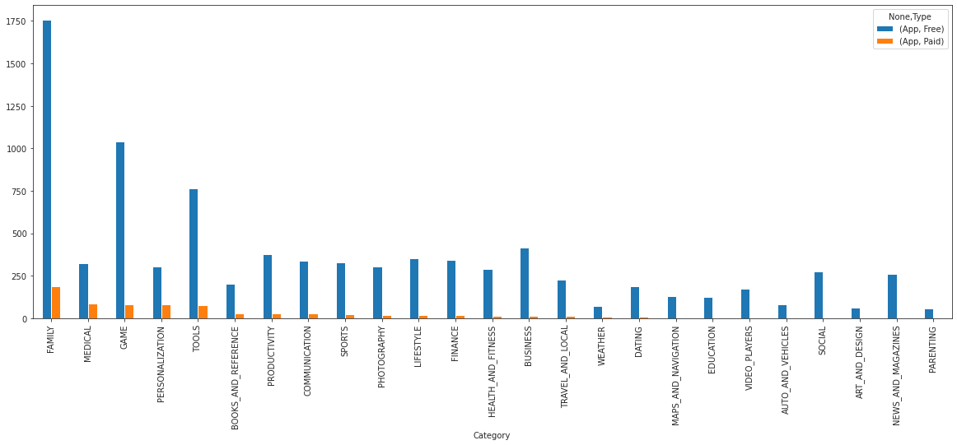
Which are the top 25 categories comprising maximum paid and free apps?
From the blow chart we can conclude that in top 25 categories, there are greater number of free apps and paid apps which are belonged from family categories:

Slide 23
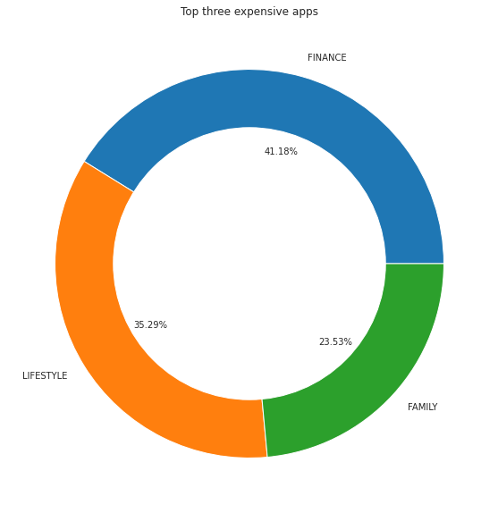
Which are the top three most expensive categories of apps?
There are many factors to consider when selecting the right pricing strategy for your mobile app. It is important to consider the willingness of your customer to pay for your app. A wrong price could break the deal before the download even happens. Potential customers could be turned off by what they perceive to be a shocking cost, or they might delete an app they’ve downloaded after receiving too many ads or simply not getting their money's worth.
From the doughnut chart we are able to find top three most expensive categories :
Finance
Lifestyle
Family

Slide 24
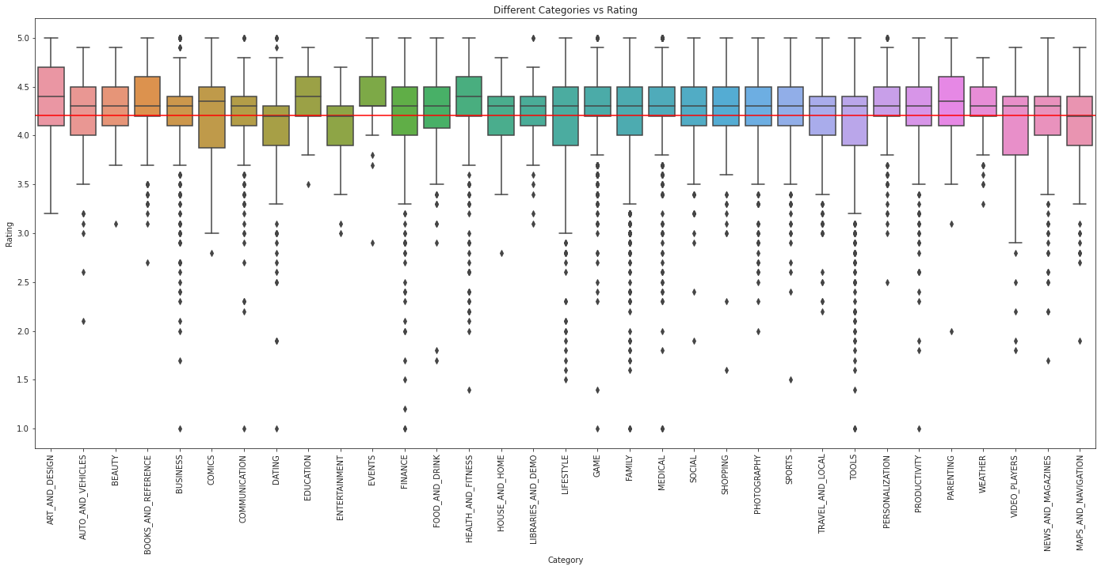
Which categories of apps are less popular?
J Conclusion

Slide 25
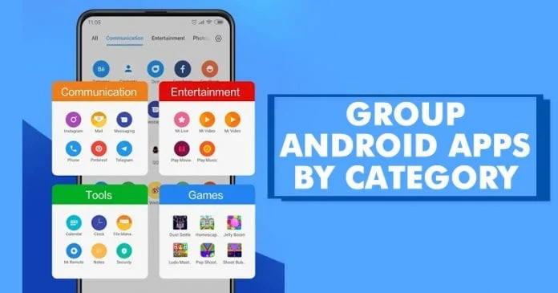
From the box plot we have conclude the variation of rating w.r.t each category of apps. The red line here shows the mean value of the rating i.e. 4.3.
We can see that most of the categories have apps with their avg rating above red line i.e. 4.3 while few categories such as dating and entertainment apps are not fondly used and rated by users.

Slide 26
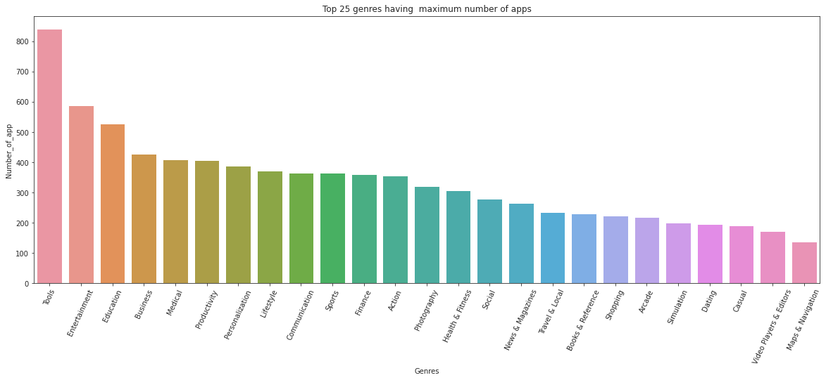
Diving into its Genres:
Top 25 genres having maximum number of apps?
From the above chart we can conclude that in top 25 genres, tools have maximum Number of App.

Slide 27
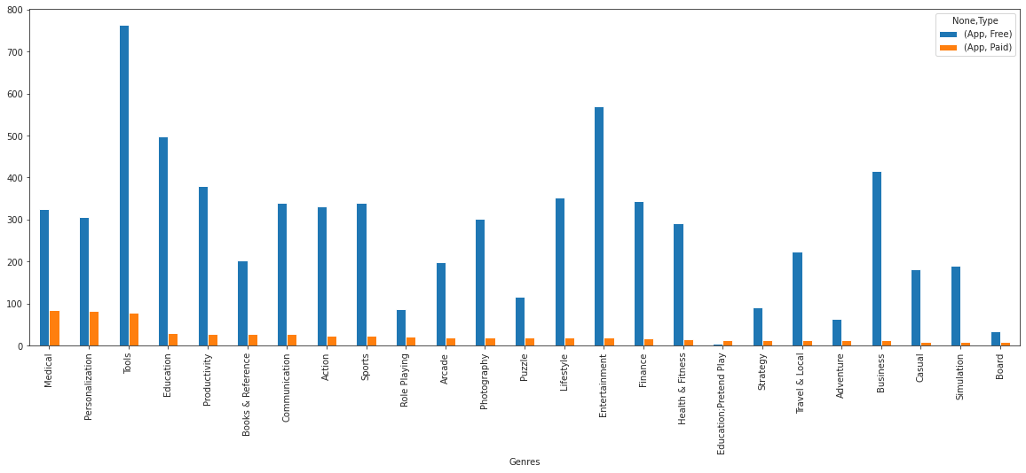
Top 25 Genres having maximum number of paid and free apps
From the above chart we can conclude that in top 25 genres, tools have maximum Number of Free App and Medical have maximum Number of app.

Slide 28
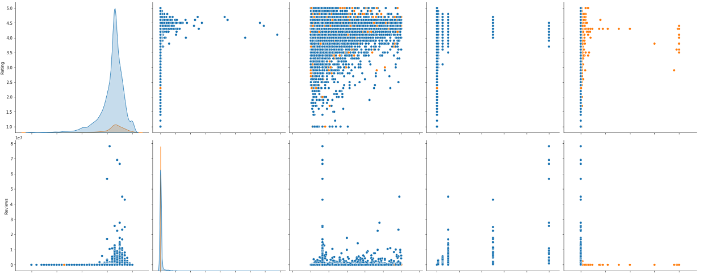
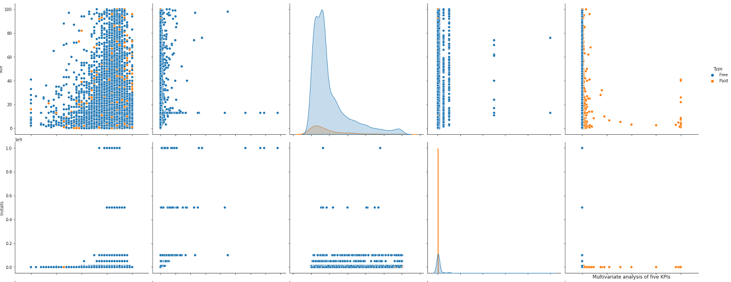
Study of KPIs through Multivariate plots:

Slide 29
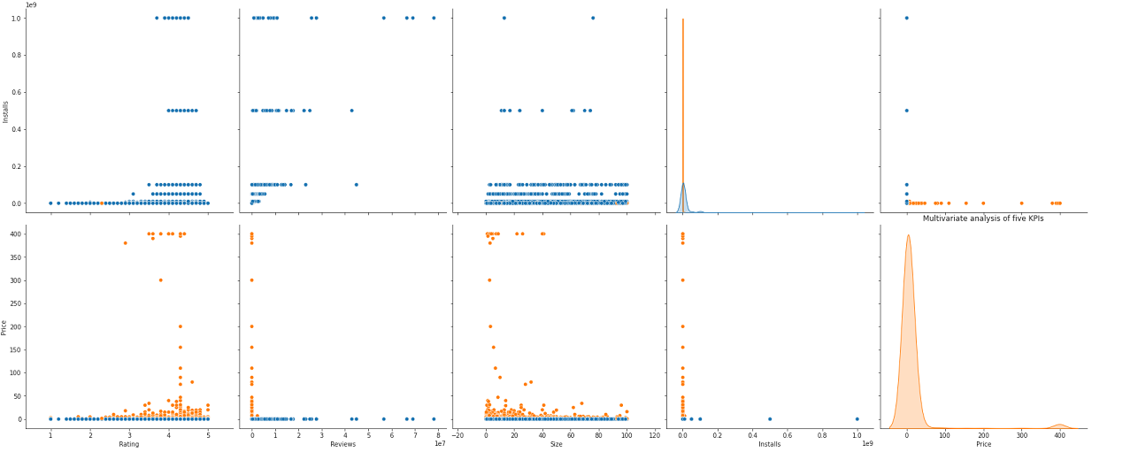
The above plot is a matrix of 5x5 graphs where rows and columns both contain 'Rating', 'Reviews', 'Size', 'Installs' and 'Price'. Here, the blue dots or line represents free users while orange ones represent paid users.

Slide 30
Description of Charts from first column starting from the charts:
Rating vs Rating- Distribution curve and peak near mode value of Ratings i.e between 4 to 5 and peak at 4.3.
Rating vs Reviews- Scatter plot here shows that as the Ratings are increasing the number of Reviews are also increasing, whether they are paid or unpaid users.
Rating vs Size- This Scatter plot shows that size of the app is also more of high rated apps.
Rating vs Installs- It shows that number of installs are more for high Rated apps.
Rating vs Price- The users have paid highly for good rated apps.
It is also interesting to discover that:
users have paid more for lite apps (graph 5x3/3x5)
Users have paid highly for good rated apps and it does not depend on number of reviews (graph (1x5 & 2x5) or (5x1 & 5x2))

Slide 31
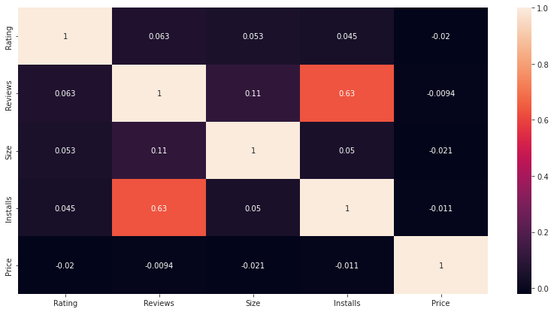
Similarly, we can analyze other graphs as well and can study the relationship between them. After studying the variation of each variable w.r.t others, let's know the correlation between them through heatmap.
Correlation between KPIs
From the heatmap we have conclude below points:
Users have installed more apps of the ones having high reviews i.e. installs and reviews are highly corelated.
Installs of app doesn't depends on Size i.e. there is no correlation between them

Slide 32
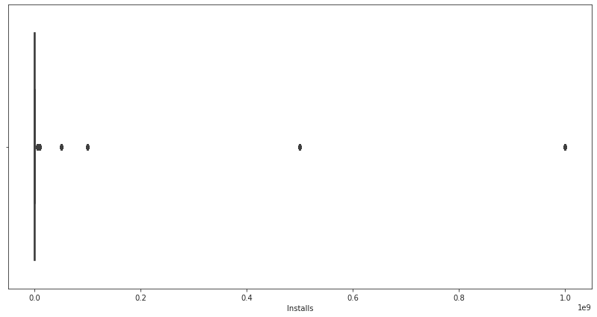
Which apps install maximum No. of time ?
From the above Boxplot chart we can conclude that few apps have installation upto 10^9. So, let's have look on those apps.

Slide 33
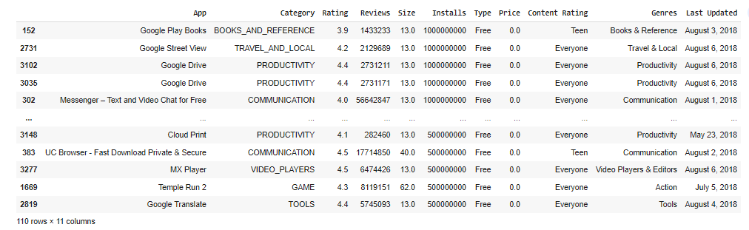
In the below table shows that, few apps are such that they are installed in every mobile and thus their 'Installs' have reached 10^9. Those obvious apps are:
Google Play Books
Google Street View
Google Drive
Messenger – Text and Video Chat for Free
Hence we can conclude that our dataset is working fine and giving correct results.

Slide 34
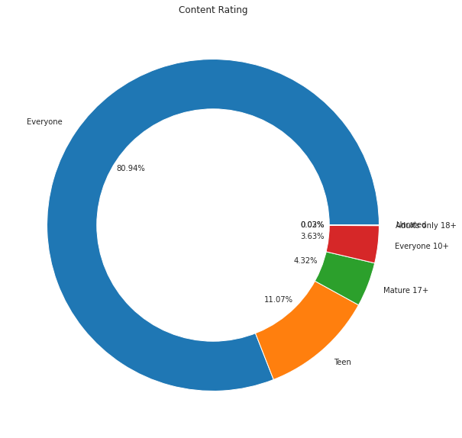
From doughnut chart we can infer that among all apps: 80.94% of apps are for everyone. while. 11.07% of apps for Teens and7.99% for others
Which audience shares maximum number of apps?

Slide 35
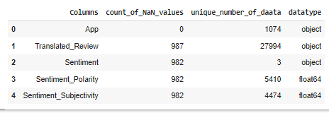
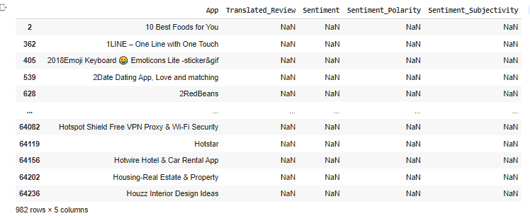
EDA on Review Dataset
Dataset Exploration: We have exploring the Data Frame by using Head and Tail method.
Dropping duplicates.
Finding nulls in 'Sentiment' column. AS near about every column has same number of missing value thus we have to close look on dataset to verify it.

Slide 36

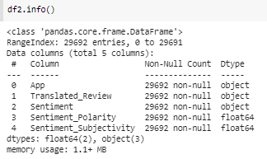
After looking at the rows it looks like all columns have NAN values except app name so it's better to drop all rows.
Looking at the info of dataset after drop all the NAN values .
DATA CLEANSING COMPLETED

Slide 37
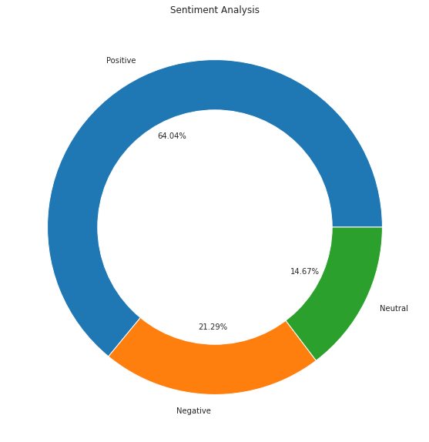
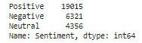
Which type of sentiments users generally prefer to give?
From the doughnut chart we are able to find top three most expensive categories :
64.04% positive sentiments
21.29% Neutral sentiments
14.67% Negative sentiments

Slide 38
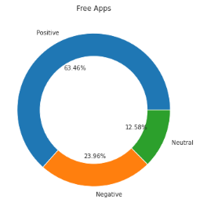
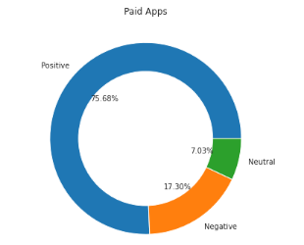
We have merged both data set for analyzing data in combined way to find the some more valuable result.
Does the sentiments differ for paid or free apps?
From the above doughnut charts we conclude that sentiments are high in paid apps.

Slide 39
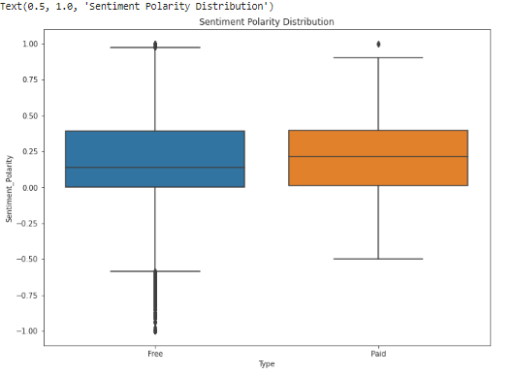
Plotting sentiment polarity scores of user reviews for paid and free apps
From these two univariate and bivariate plots on sentiment polarity vs type, we can observe that users gave more positive sentiments, for paid apps, while looking at the outliers of box plot we can say that they were more harsh while giving reviews for free apps. It means paid apps have high quality than of free apps in general. Also, it can be inferred that neutral sentiments are less for paid ones i.e. users are true to reviews once they have paid for it

Slide 40
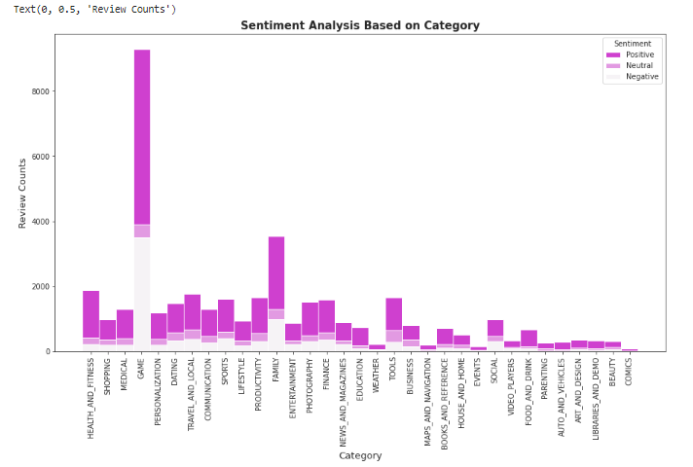
Which category of apps have got more number of reveiws with positive sentiments?
From this graph clearly shows that users gave maximum reviews for game category followed by family. Also the positive and negative sentiments are highest for games category.

Slide 41
Conclusion
The marketplace is crowded with all types of mobile apps as it has enormous potential to drive app-making businesses to success. Actionable insights can be drawn for developers to work on and capture the Android market.
Today, even businesses who never would’ve needed apps in the past are getting into the game to meet customer demand for an app that makes their lives easier or to stay ahead of the tech curve.
Thus, through this exhaustive analysis of approx. 10k apps we discovered following key factors responsible for app engagement and success in recent study:
We found that among 33 unique app categories present in our dataset, apps related to Games and Medical have the highest market prevalence according to their ratings though there are greater number of apps related to family and tools as well.
But, the number of installs are higher for Communication, Social and productivity genres whereas Tools, Entertainment, Education related genres have maximum number of apps among all 119 genres.
It was interesting to note that
Users have paid more for lite and high rating apps.
Users have installed more apps of the ones having high reviews
Installs of app doesn't depends on Size.
From the sentiment analysis we found users showed more positive sentiments for paid apps and were harsh while showing sentiments for free apps. Also, Neutral sentiments were less for paid ones** i.e. users were true to reviews once they have paid for it.
Users gave maximum reviews for game category followed by family. Also the positive and negative sentiments were highest for games category.

Slide 42
